Slide 1
I –nastava: distance learning Lessons learned and ways forward

Slide 2
Foreign language teaching experiences in Croatia during the Covid-19 pandemic
Sonja Rupčić Petelinc, mag.chem.
Team leader for distance learning Ministry of Science and Education
Loreana Selišek Butina, M.A. XV. gimnazija, Zagreb
French team leader
Kristina Pirs, M.A. Elementary school Mejaši, Split
French team coordinator

Slide 3
Workshop outcomes:
To explain three - way organization of distance learning in Croatia,
To explain the support given to teachers and students by the Ministry of Science and Education and Teacher Training Agency,
To motivate collegues to use examples of good practice in their work.

Slide 4
3 ways of organizing distance learning
Lessons broadcasted on national TV channels Škola na trećem
Young learners – TV programme
Students aged 11 – 18 - Video lessons broadcasted
Video lessons I-nastava
Ministry of Education’s YouTube channel
Virtual classrooms
MC Teams, Google classroom

Slide 5
Croatian
Radiotelevision
Croatian Ministry of
Science and Education
Education and
Teacher Training
Agency

Slide 6
Teaching on TV „ Škola na trećem”
The young learner (age 7-10) TV programme broadcasted on national television channels
4 hours daily for each class level
Subjects: Croatian language, Mathematics, Science, Physical Education, Music and Art
Programme made according to Croatian National Curriculum
Teaching scenarios were prepared several days in advance

Slide 7
1. Teaching on TV „ Škola na trećem”
School year 2020/2021
680 TV programmes
School year 2021/2022
161 TV programmes
63 experts (teachers and teacher training advisors)
15 experts

Slide 8
VL
https://youtu.be/yhrhwFQlGK8
https://youtu.be/zaMhoYLXDJg
https://youtu.be/6xRYqEx2muk

Slide 9
School year 2021/2022 2.168 VL
School year 2020/2021 7.465 VL
700 teachers + teacher training advisor

Slide 10
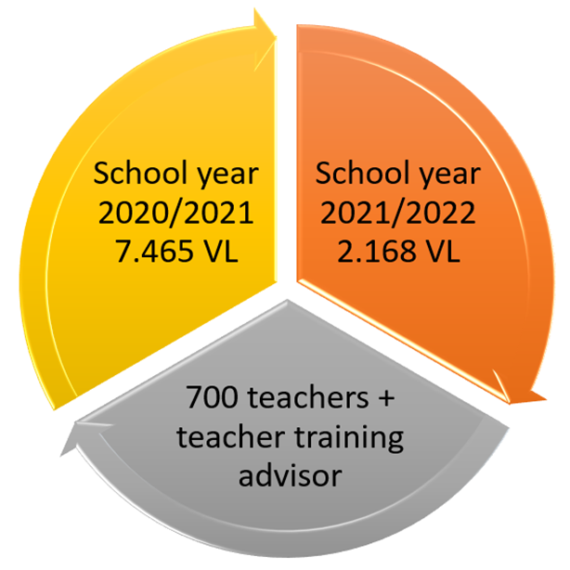
2. Video lessons (pupils 11 – 18)
Video lessons for each subject according to National Curricula
VL broadcasted on TV
VL on YouTube channel of Ministry of Science and Education
VL posted in Virtual classroom
VL dealing with state Matura (graduation) activities

Slide 11
Designing and developing video lessons
Power Point presentation (voice, camera) turned into video
the activity outcomes according to Croatian national curriculum were presented to students at the beginning of each VL
for French language the outcomes deal with :
communicative competence,
intercultural competence,
language learning autonomy.
school materials prepared for downloading

Slide 12
Designing and developing video lessons
several languages activities always followed by formative assessment activities (for learning and by learning - including self assessment and peer assessment)
for assessment, different digital tools like: Edpuzzle, MS Forms, Wordwall, LearningApps, Bookwidgets, Genially and Thinglink were used.
active pupils / students
successful learning / academic performance

Slide 13
Time and classroom management
VL begins with teacher’s instruction regarding the school materials needed
Activities and tasks are preceded by clear instructions
students task in each moment of the VL
how to open an external link

Slide 14
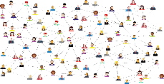
Pour cette leçon vous avez besoin
d'un cahier ​
d'un crayon / d'un stylo​
d'un ordinateur / d'un portable​
d’une connexion à Internet
Vous pouvez arrêter et redémarrer cette leçon à tout moment !​

Slide 15
Upute za rad
Écoutez !
Répétez !
Parlez !
Écrivez !
Jouez !
Lisez !
Coloriez !

Slide 16
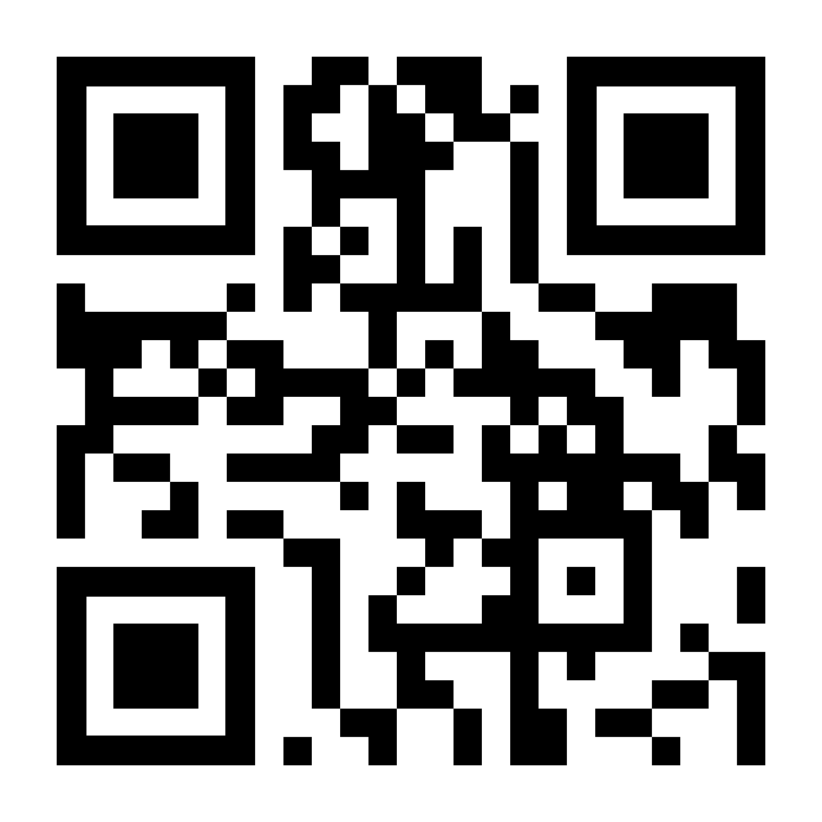
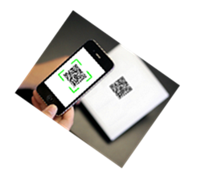
Activité 1 : Les magasins
Ce lien vous permet l'accès direct à l'activité https://bit.ly/magasins6
Scannez ce QR code avec votre smartphone.
Le quiz : une série de questions à choix multiple.
Appuyez sur la bonne réponse pour continuer.

Slide 17
Les magasins :
la boulangerie
la boucherie
la pâtisserie
le magasin de produits laitiers
la poissonnerie
le fleuriste
la librairie
la papeterie
la pharmacie
le magasin de vêtements et de chaussures
le supermarché
le marché
le magasin de jouets

Slide 18
Time and classroom management
Duration 15 to 20 minutes corresponds to 90 minutes in class (two periods)
French language 4th grade (10-year-olds) Project: La Fête de la musique
Notes:
https://www.youtube.com/watch?v=zaMhoYLXDJg&t=3s&ab_channel=i-nastava
https://youtu.be/yhrhwFQlGK8

Slide 19
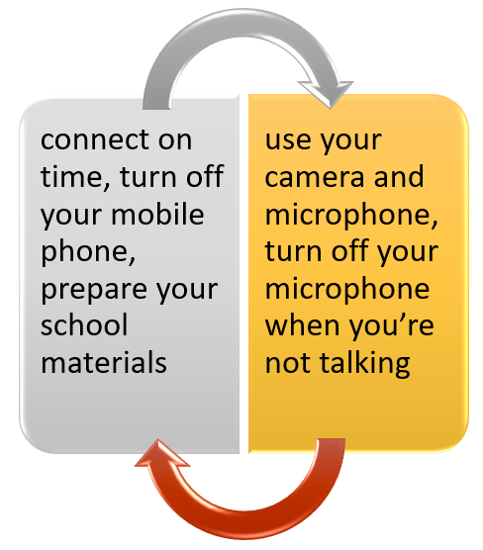
3. Hybrid learning in virtual classrooms
Virtual clasrooms rules

Slide 20
Hybrid learning in virtual classrooms
Type of activities (reading, listening, speaking, writing, language mediation)
Tasks that boosted students activity
Formative assessement (digital tools)
Intitutional support given to students (computers, teachers’ help using the equipement)

Slide 21
Hybrid learning in virtual classrooms
Virtual lessons lasted 40 minutes
Teaching in VC was really challenging but students accepted this way of learning and tried to be as active as they could.
Platforms provided by the Ministry of Science and education and Croatian Academic and Research Network
MS Teams, Loomen, Google Classroom
For sign in teachers and students use their AAI identity
Digital identity name.familyname@skole.hr

Slide 22
Conclusion - Lessons learned and ways forward
Interactive lessons made by the aid of different digital tools proved to be effective in developing learning competences but also keeping students active and motivated for language learning in classrooms as well as in virtual classrooms.
Teachers in Croatia shifted to online teaching rather quickly, due to well organized teaching and learning platforms, already existed (before the Covid pandemic)
Teachers supported each other in different challenges.
Teachers shared teaching materials and activities.

Slide 23
Webography
https://www.azoo.hr/najave-i-izvjesca-arhiva/hibridno-ucenje-i-poucavanje-iz-francuskoga-jezika/
https://mzo.gov.hr/news/coronavirus-organisation-of-distance-teaching-and-learning-in-croatia/3634
https://i-nastava.gov.hr/
https://mzo.gov.hr/news/coordinated-research-and-innovation-actions-across-the-eu-to-reinforce-the-fight-against-covid-19/3669

